Slide 1
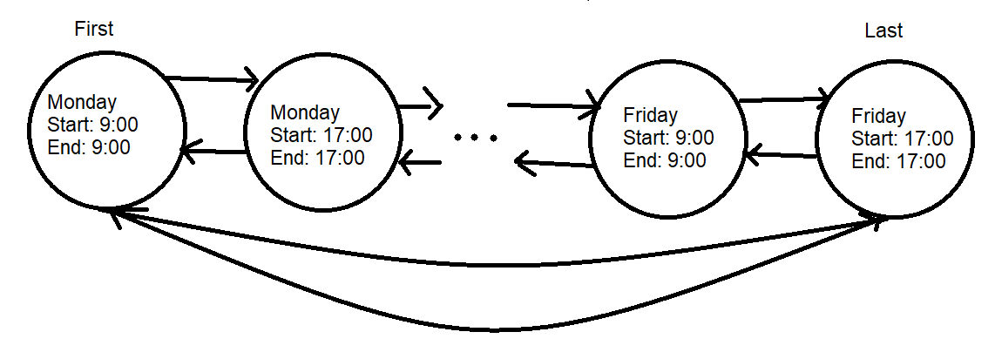
Sentinel Nodes

Slide 2
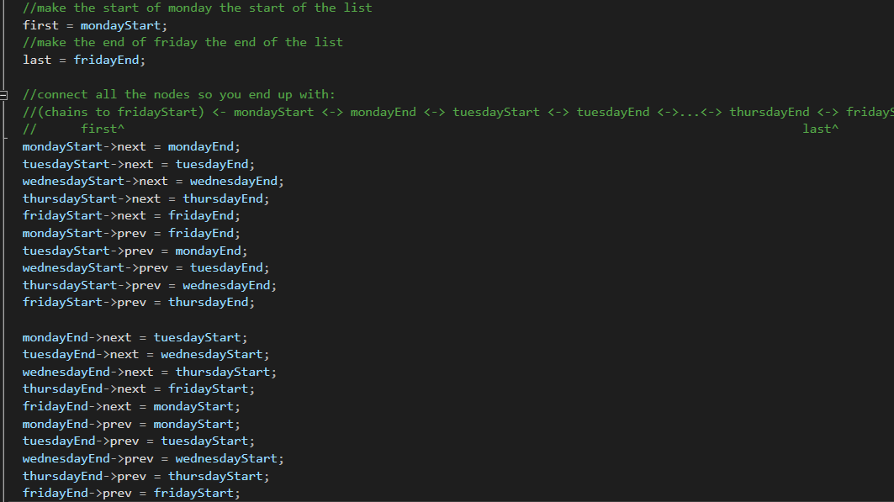
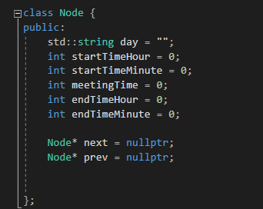
What each node contains
Each dayStart is set to start/end of 9:00
Similarly,
each dayEnd is set to start/end of 17:00
This is set up like this to ensure later it can be used to determine a node is a sentinel, and for comparing boundaries

Slide 3
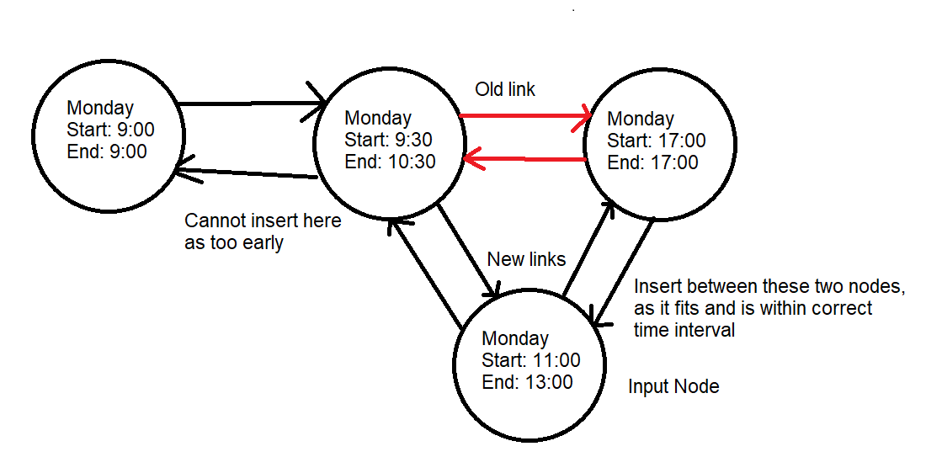
Module 1: Insertion at correct time

Slide 4
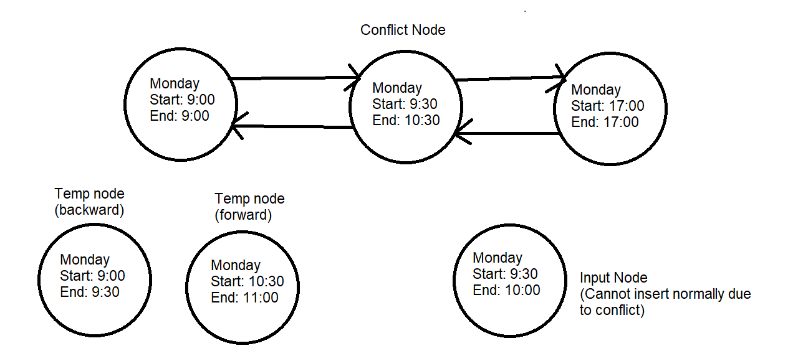
Module 2: Insertion at correct day, different time

Slide 5
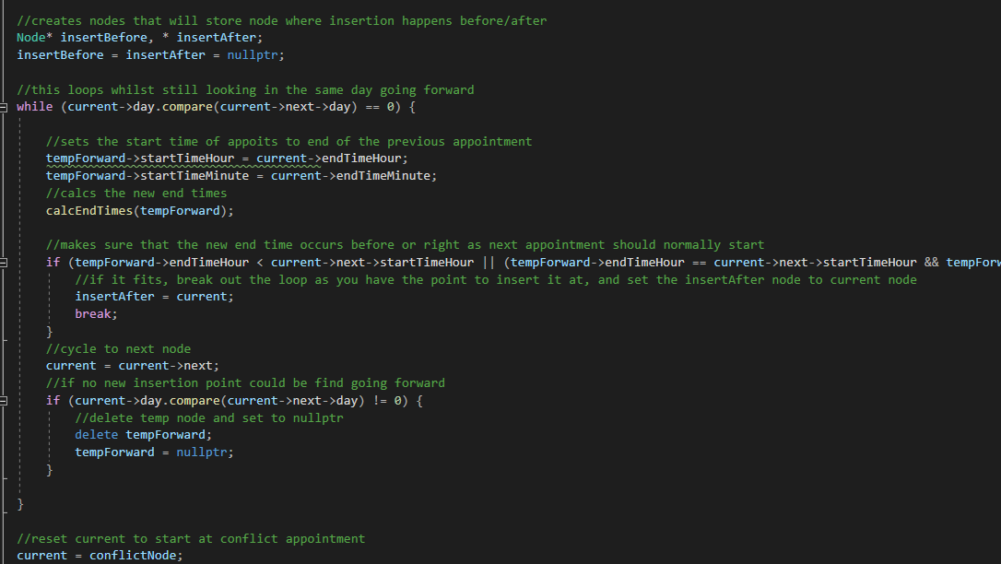
So, a common theme in these insertions will now be looking forward and backwards to see if there is a free slot
These if statements might look complicated, but all it is checking is if current planned time end Is <= next already appointed start time
It checks if the hour is before, or if the hour is the same if the minute is before, if it works, mark it

Slide 6
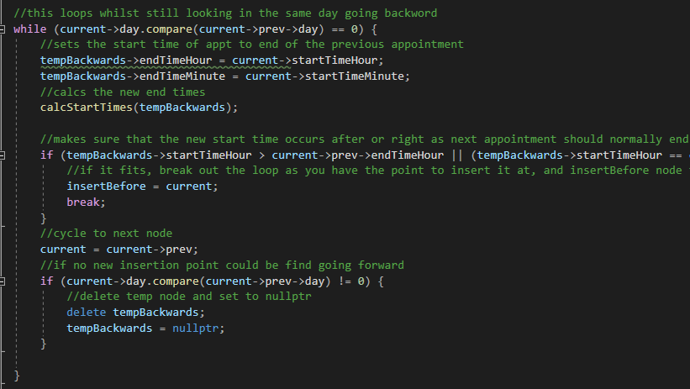
Similarly, this is simply looking for if the current planned start time is <= prior already appointed end time
It just checks if the hour is before, and if it’s the same if the minutes are before or equal

Slide 7
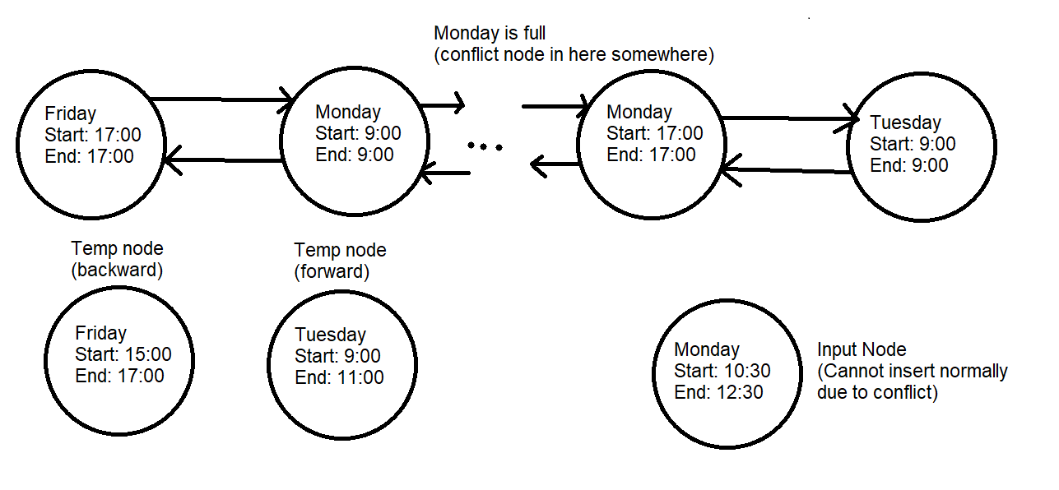
Module 3: Insertion at different day

Slide 8
Idea is same as for same day different time
Just going to loop forward and backwards to see if a free slot exists

Slide 9
The Importance of Refactoring
You could probably tell from my code it is a bit messy, it is logical, but messy nonetheless
So, this will be a brief portion pointing out things that could have been done better, to show how important it is to refactor once you get the main code done
Not only would it make the code cleaner, but you may have noticed prior logic errors and efficiency flaws

Slide 10
Potential Fix 1:
From module 2 and 3 you may have realized that they are basically the same
So, I could have instead of making it 2 modules, just made it one
This would have greatly improved code readability because instead of 4 for loops, there are 2, and they are basically serving the same purpose

Slide 11
Potential Fix 2:
You may have noticed the insertion function is quite large
What I could have done is instead of having all the modules defined within the function is I could have made them their own functions called by it
This would better break up the code, improving readability, and would make it easier to test portions of it for testing purposes as they are in smaller units now

Slide 12
Potential Fix 3:
There was a logical error I had not noticed at first related to determining if inserting going ahead or backwards was closer to initial appt. time (assuming 2 insertion points were found)
For determining it across different days I had created variables to just track the overall wait time, and that works and was fine
But, for determining a different spot in the same day I used the logic of if it is in the first half of the workday it defaults one way, else the other
The reason I had done this is simply because I thought it was true in all cases, since it is the case in many cases, but there are some counter-examples to it that I did not think of until after
So, I should have also implemented the wait time tracker to it too, this would also work well with Potential Fix 1, as I could have combined them as well also helping code readability

Slide 13
Potential Fix 4:
As you may have noticed, there are a few kind of messy and relatively complicated if-statements
This could have been amended if I had simply designed a class that holds the start time and end time instead of tracking them as hours and minutes separately themselves
This way, I could have just defined a less than logic to it to use, and so I would only have had to design it once and could have reused it, and it would have improved code readability making it far easier to understand what is going on

Slide 14
Potential Fix 5:
One flaw of this system, which primarily affects the user, is that you have to input the wait time in minutes to work
To fix this, I could have better designed my parameters and validity checks to distinguish hour inputs and minute inputs and just convert the way I needed for performing other functions
The reason this is an issue is it makes it needlessly more complicated on the user to input appointments

Slide 15
Potential Fix 6:
You may have noticed there were several cases of repeated code, namely when it came to actually inserting the node after the correct spot was found
This could have been fixed by creating separate insertion functions that were called as needed
Doing this would just aid in readability of the overall program, as it would be more obvious what was happening, instead of just seeing repeated chunks of code

Slide 16
Questions?

